Slide 1

Lecture Containers and Layouts
DT228/3
Dr. Susan McKeever

Slide 2
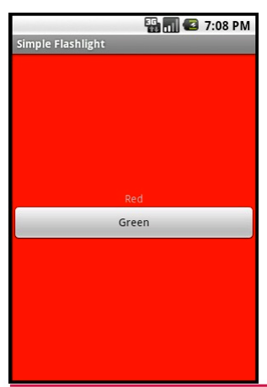
Containers – <Linear Layout> example
Code sample..

Slide 3
Relative layout and constraint Layout
Both based on specifying positions of views relative to other - that hold no matter what the screen size
ConstraintLayout has some extra features
Weight & bias
https://developer.android.com/reference/android/support/constraint/ConstraintLayout

Slide 4

Relative layout
Example – typical form
The input field is to the right of the Name label
The “Name” label is aligned with the Left of the screen
The two buttons are below the input field, and to the right side of the screen
And the tags used are..
<RelativeLayout>
<TextView>
<EditText>
<Button>
Name
Cancel
OK

Slide 5
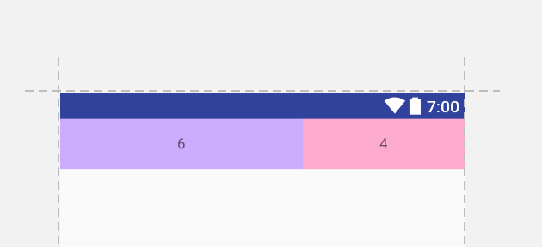
Constraint Layout
Adding “weights” - see code sample
Adding “bias” - horizontal and vertical bias which is % of displacement from the centre.
<Button
android:id="@+id/button1"
android:layout_width="wrap_content"
android:layout_height="wrap_content"
android:text="Click me"
tools:layout_editor_absoluteX="188dp"
tools:layout_editor_absoluteY="432dp"
app:layout_constraintRight_toRightOf="parent"
app:layout_constraintLeft_toLeftOf="parent"
app:layout_constraintHorizontal_bias="0.5"
app:layout_constraintTop_toBottomOf="@id/Label1"
Note! To define a view's position in ConstraintLayout, you must add at least one horizontal and one vertical constraint for the view – otherwise floats up to 0,0

Slide 6
Other containers too..
<TableLayout>
<AbsoluteLayout> - deprecated – why?
<ScrollView>
<WebView> - to display a web page in an app

Slide 7
Special container <Webview>
XML
<?xml version="1.0" encoding="utf-8"?> <WebView xmlns:android="http://schemas.android.com/apk/res/android" android:id="@+id/webview" android:layout_width="fill_parent" android:layout_height="fill_parent" />
To load the website.. Use the loadURL method of the Webview class in your activity:
WebView myWebView = (WebView) findViewById(R.id.webview); myWebView.loadUrl("http://www.cnn.com");

Slide 8
Special container <Webview>
Your app must have permission to access the internet
Manifest file – INTERNET PERMISSION must be set
<manifest ... > <uses-permission android:name="android.permission.INTERNET" /> ...
</manifest>

